Slide 1
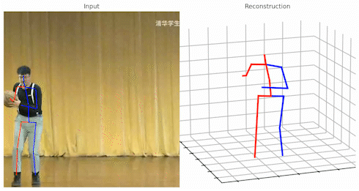
AI-enhanced Smart Physical Rehabilitation
Xian Gao, Molly Meadows, Noah Rieth
Value Proposition
Injury is prolonged due to improper completion of physical therapy exercises
Instead of paying extra money to see a physical therapist weekly:
We will attempt to create a model that gives feedback which includes:
How accurate
How you can improve
Current Objectives
Extract skeletal data from pictures and videos using existing python libraries:
PoseFormerV2
BlasePose
VideoPose3D
OpenPose

